Slide 1
Whats new in C#

Slide 2
About me:
Jarosław Stadnicki
jaroslaw.stadnicki@gmail.com
@j_stadnicki
jstadnicki.blogspot.com

Slide 3
Sounds like a plan
Null Conditional Operator
Name Of Expressions
Primary Constructor
Expression Bodied Functions And Properties
Static Using Syntax
Autoproperty Initializers
Dictionary Initializers
String Interpolation
Exception Filters
Async Catch

Slide 4
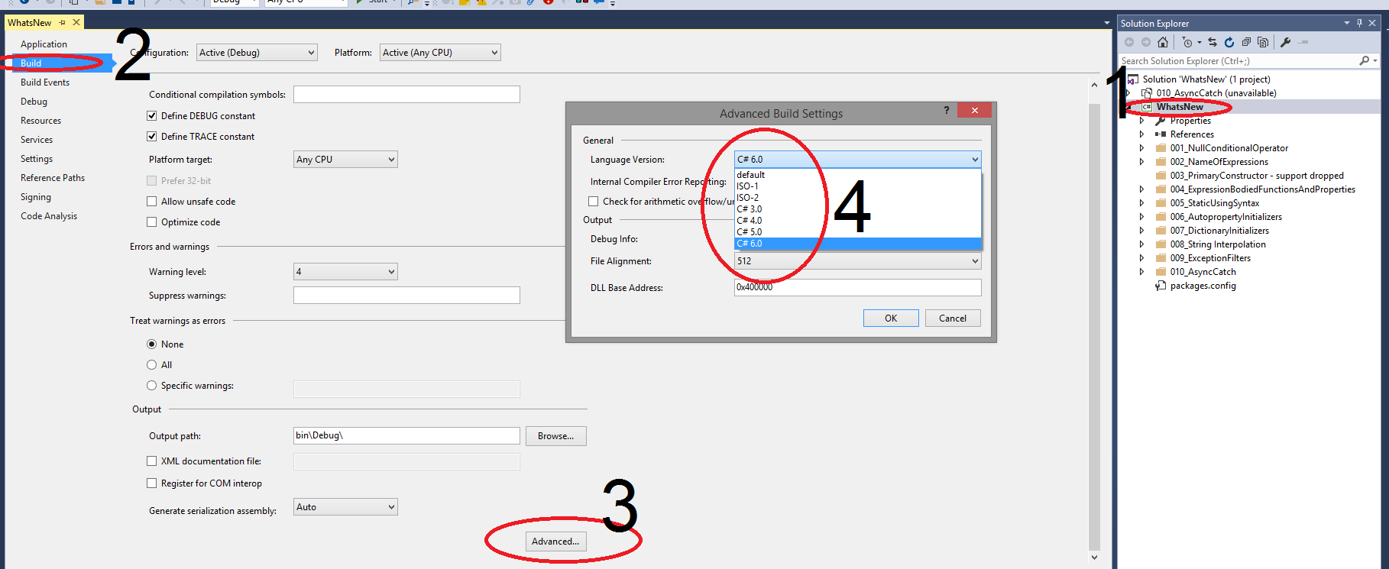
Enabling C# 6

Slide 5
Null Conditional Operator
public string TrimChildTextWithIf(Node item) { if (item == null) { return string.Empty; }
if (item.Child == null) { return string.Empty; }
if (string.IsNullOrEmpty(item.Child.Text)) { return string.Empty; } return item.Child.Text.Trim(); }
public string TrimChildTextWith6(Node item) { return item?.Child?.Text?.Trim() ?? string.Empty; }

Slide 6
Name Of Expressions
public static string ParameterName(object o) { return "inputParameter"; } public static string ClassName() { return "NameOfExpression"; } [NameOfExpressionDemo] public static string AttributeName() { return "NameOfExpressionDemoAttribute"; }
public static string ParameterName( string inputParameter) { return nameof(inputParameter); } public class NameOfExpression { public static string ClassName() { return nameof(NameOfExpression); } }
[NameOfExpressionDemo] public static string AttributeName() { return nameof(NameOfExpressionDemoAttribute); }

Slide 7
Primary Constructor
Not supported

Slide 8
Expression Bodied Functions And Properties
public class ExpressionBodyNew { private string _somePropertyValue; public string SomePropertyValue => _somePropertyValue; public ExpressionBodyNew(string input) { _somePropertyValue = input; } public string SomeSimpleMethod() => string.Format("{0}x{0}", SomePropertyValue, SomePropertyValue); }
public class ExpressionBodyOld { public ExpressionBodyOld(string input) { SomePropertyValue = input; } public string SomePropertyValue { get; private set; } public string SomeSimpleMethod() { return string.Format("{0}x{1}", SomePropertyValue, SomePropertyValue); } }

Slide 9
Static Using Syntax
[TestFixture] public class OldTestDemo { [Test] public void T001_OldWayOfCalling() { Assert.AreEqual("Ala ma kota", DemoClass.ReturnSomeText()); } }
using static DemoClass; [TestFixture] public class NewTestDemo { [Test] public void T001_NewWayOfCalling() { Assert.AreEqual("Ala ma kota", ReturnSomeText()); } }

Slide 10
Autoproperty Initializers
public class AutoInitializePropertyClassOldWay { public AutoInitializePropertyClassOldWay() { PropertyValue = "hello si sharp"; } public string PropertyValue { get; set; } }
public class AutoInitializePropertyClassNewWay { public string PropertyValue { get; set; } = "hello si sharp"; }

Slide 11
Dictionary Initializers
public OldDictionaryClass() { dictionary = new Dictionary<string, string> { {"Hello","World" }, {"Si","Sharp" } }; }
public NewDictionaryClass() { dictionary = new Dictionary<string, string> { ["Hello"] = "World", ["Si"] = "Sharp" }; }

Slide 12
String Interpolation
public string OldFormatText (double price, DateTime date) { return string.Format("{0:d} {1:C}", date, price); }
public string NewFormatText (double price, DateTime date) { return $"{date:d} {price:C}"; }

Slide 13
Exception Filters
try { throw new Exception("500"); } catch (Exception e) { if (e.Message == s) { return "handled"; } if (string.IsNullOrEmpty(e.Message)) { return string.Empty; } throw; }
try { throw new Exception("500"); }
catch (Exception e) when (e.Message == s) { return "handled"; } catch (Exception e) when (string.IsNullOrEmpty(e.Message)) { return string.Empty; } catch (Exception) { throw; }

Slide 14
Async Catch
Error CS1985 Cannot await in a catch clause
Error CS1984 Cannot await in the body of a finally clause
try { await TestClass.ThrowsAsync(); } catch (Exception) { await TestClass.CatchAsync(); } finally { await TestClass.FinallyAsync(); }

Slide 15
The Road to C# 7 Has Begun

Slide 16
Questions

Slide 17
Thank you. Please give feedback jaroslaw.stadnicki@gmail.com

